Slide 1

TRAFFIC VIOLATION DETECTION SYSTEM
19AIE303 – SIP
TEAM MEMBERS:
Apoorva M
Tanuj M
Aishwarya V

Slide 2
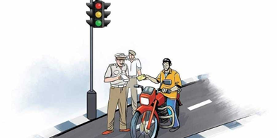
OBJECTIVES
Automate traffic signal violation detection
Make it easy for the traffic police department to monitor the traffic
Detecting and tracking the vehicle and their activities accurately

Slide 3
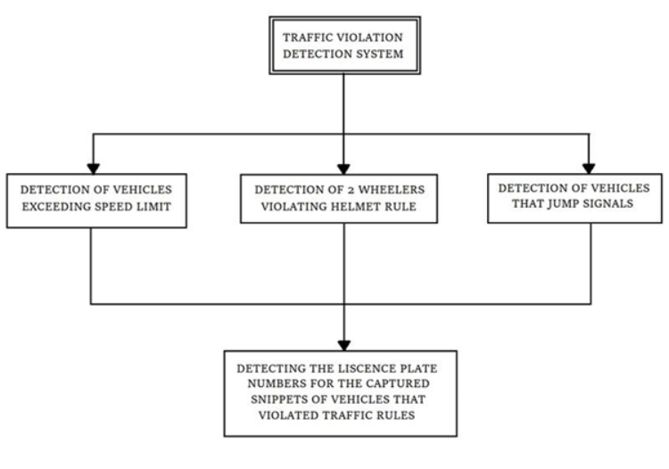
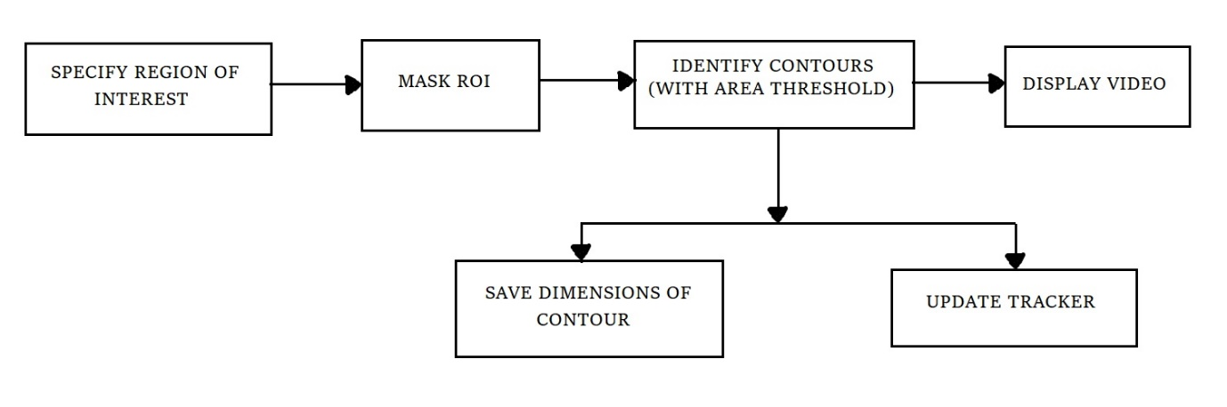
SYSTEM OVERVIEW

Slide 4
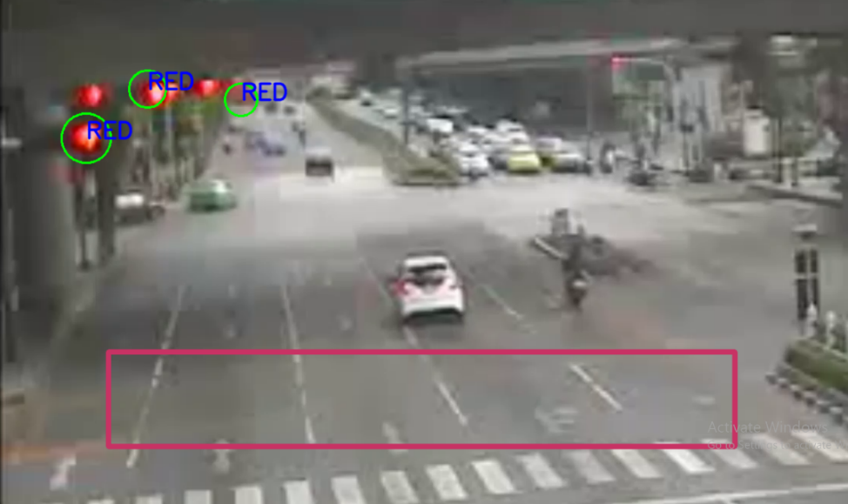
SIGNAL VIOLATION
VIDEO ACQUISITION
OBJECT RECOGNITION
REGION OF INTEREST
SIGNAL COLORS

Slide 5
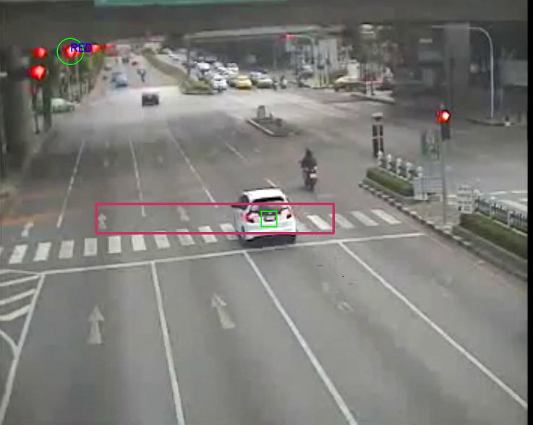
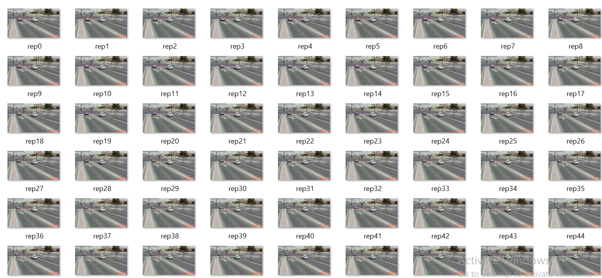
SAVING VEHICLE DATA

Slide 6
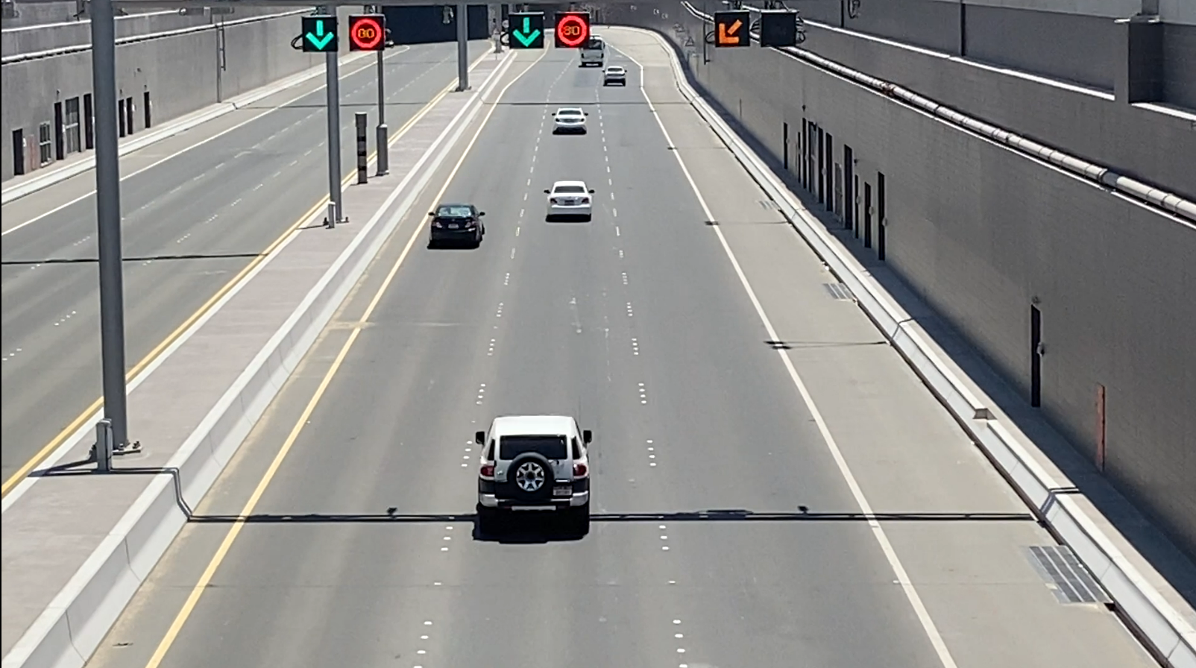
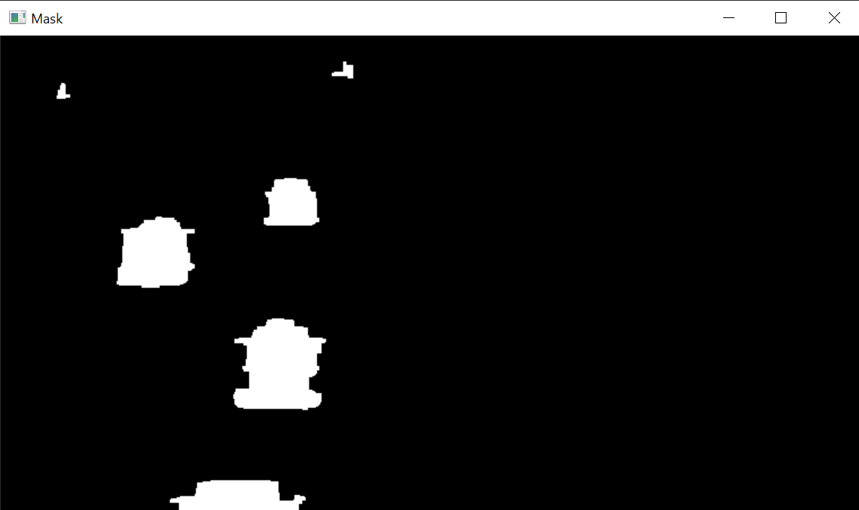
PROJECT MODEL – OBJECT TRACKING
DETECT CONTOURS
OBJECT TRACKER
ELIMINATE
BASED ON AREA

Slide 7


SPEED ESTIMATION
CAPTURE IMAGE and
SAVE SPEED
END TIMER s2[ID]
START
TIMER
s1[ID]

Slide 8
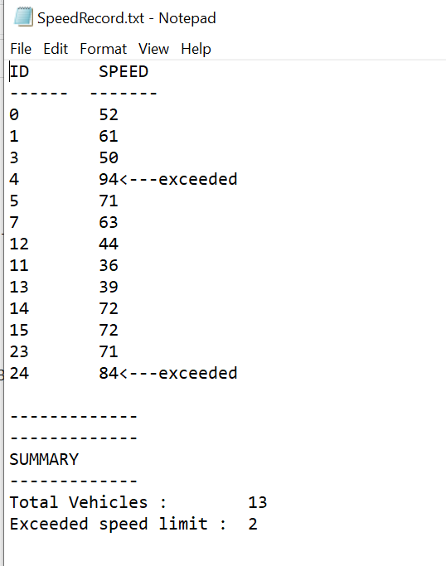
SAVE VEHICLE DATA
TRAFFIC RECORDS
ID_SPEED_60.txt

Slide 9
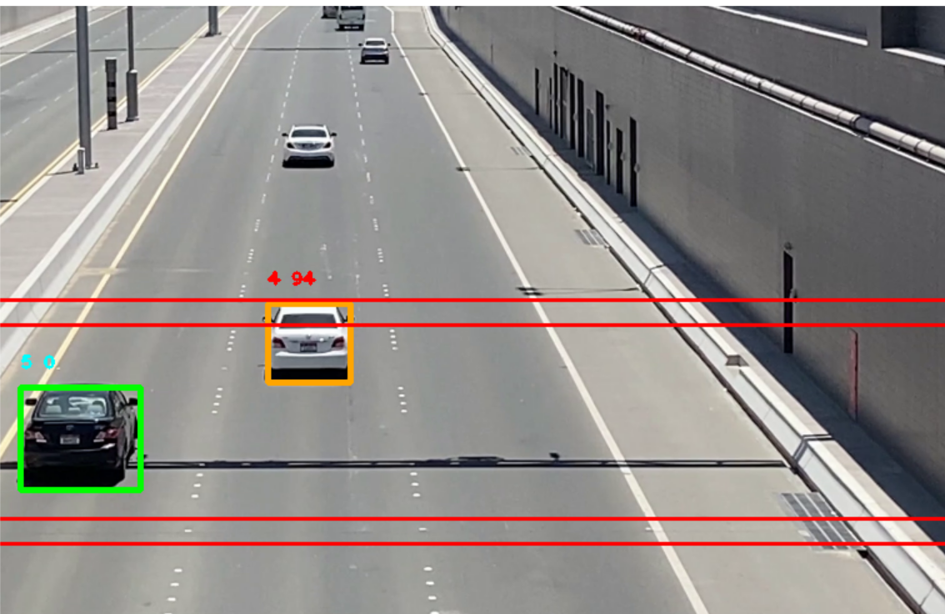
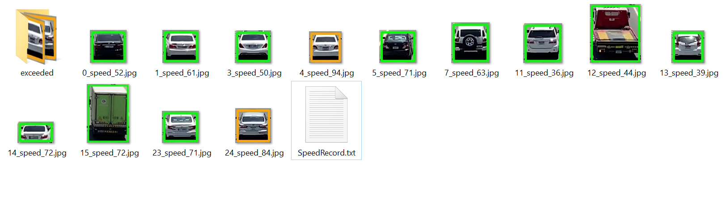
SCREENSHOTS

Slide 10
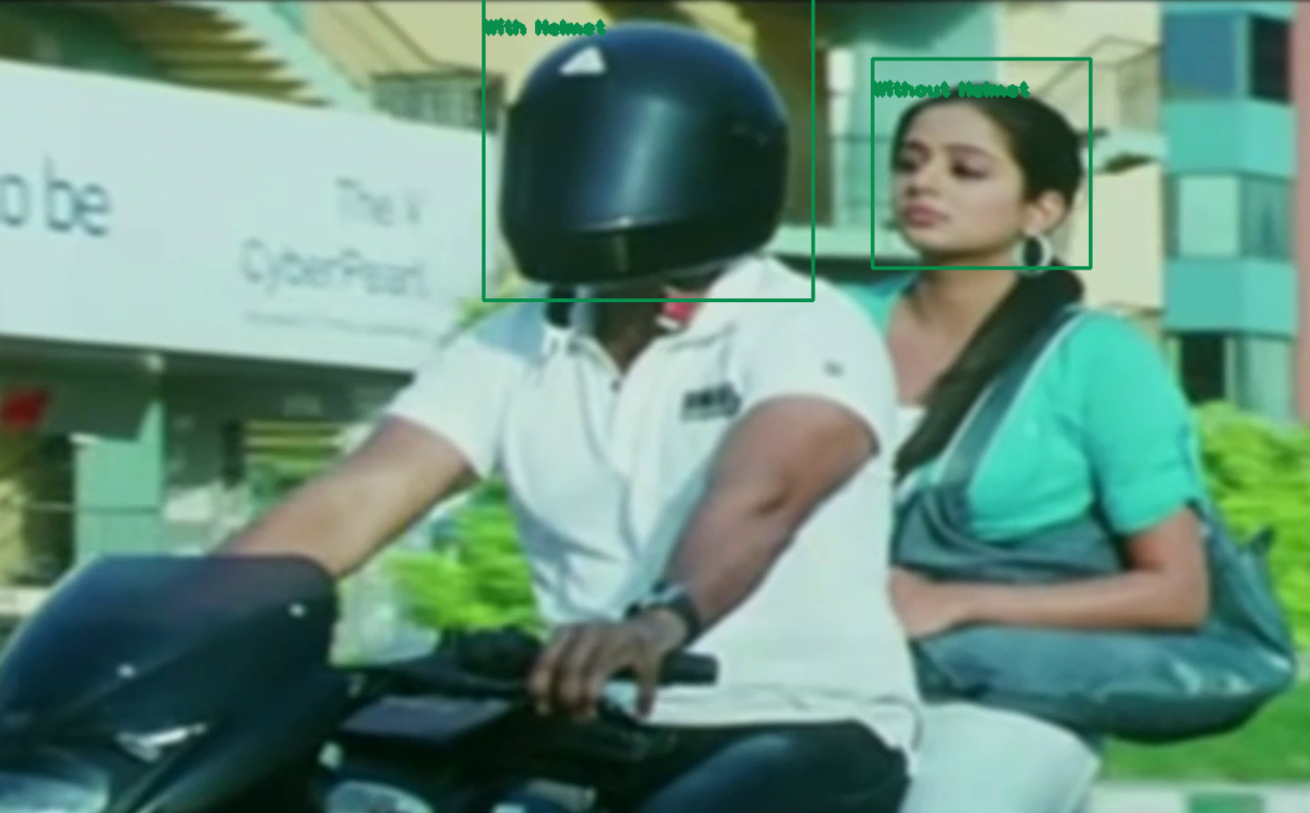
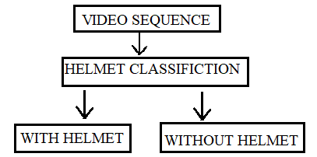
HELMET DETECTION
YOLO V4 - DARKNET
OBJECT DETECTION MODEL

Slide 11
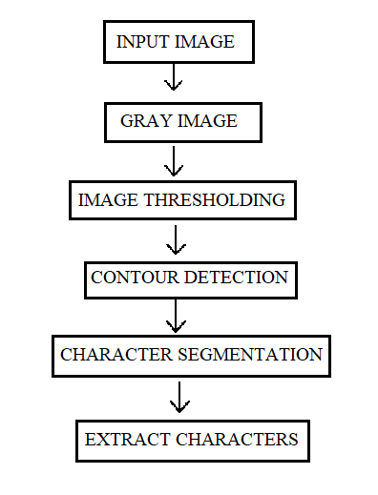
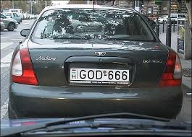

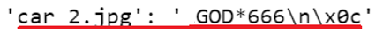
LICENSE PLATE DETECTION

Slide 12
PROJECT CHALLENGES AND UPDATES
Objects that weren’t vehicles were being detected
Number Plates Unreadable
Multiple vehicles speeds were unable to be detected
Vehicles close together were clubbed as single object

Slide 13
CONCLUSION AND FUTURE SCOPE
A traffic violation detection system must be realized in real-time as the authorities track the roads all the time.
The idea behind this project was to successfully implement detection systems for keeping check of specific road safety rules being followed.
We’ve taken care of detecting vehicles exceeding the speed limit, violating helmet rule, jumping signal, and the license plates of those vehicles are also detected.
Extend this project in detecting other traffic violating rules.

Slide 14

THANK YOU

